Slide 1
UML Diagrams
Presentation 4
Attendance System
Course: CSE 4408 – System Analysis and Design Lab

Slide 2
Team Composition
Member Name | Member ID
Mohammad Ishrak Abedin | 160041051
Shakleen Ishfar | 160041029
Anika Tasnim Preoty | 160041044

Slide 3
Use Case Diagram

Slide 4
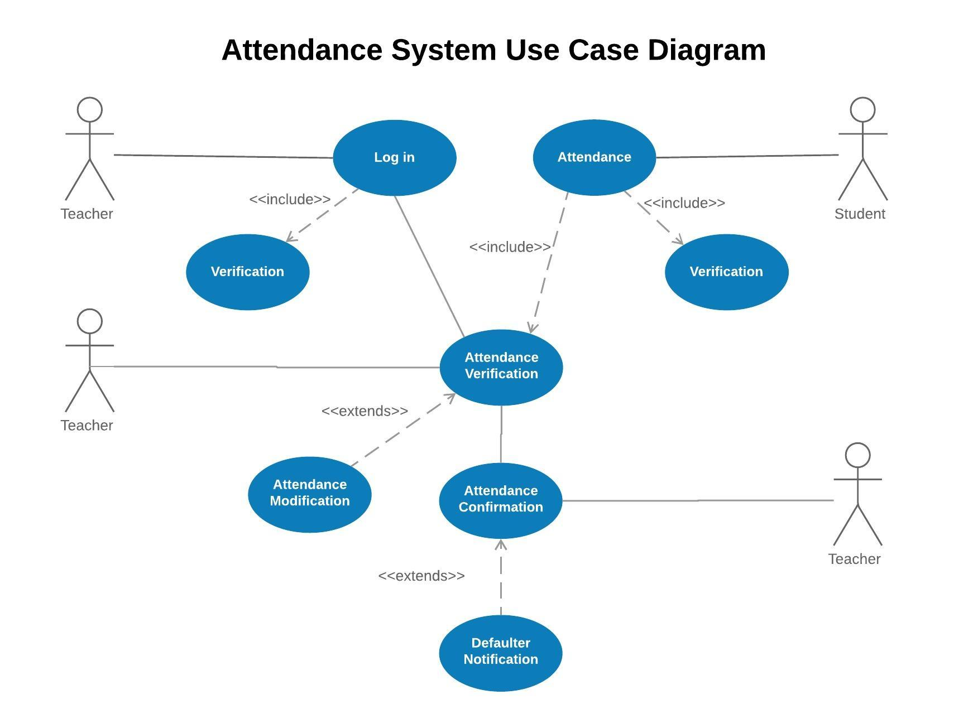

Slide 5
Activity Diagram

Slide 6
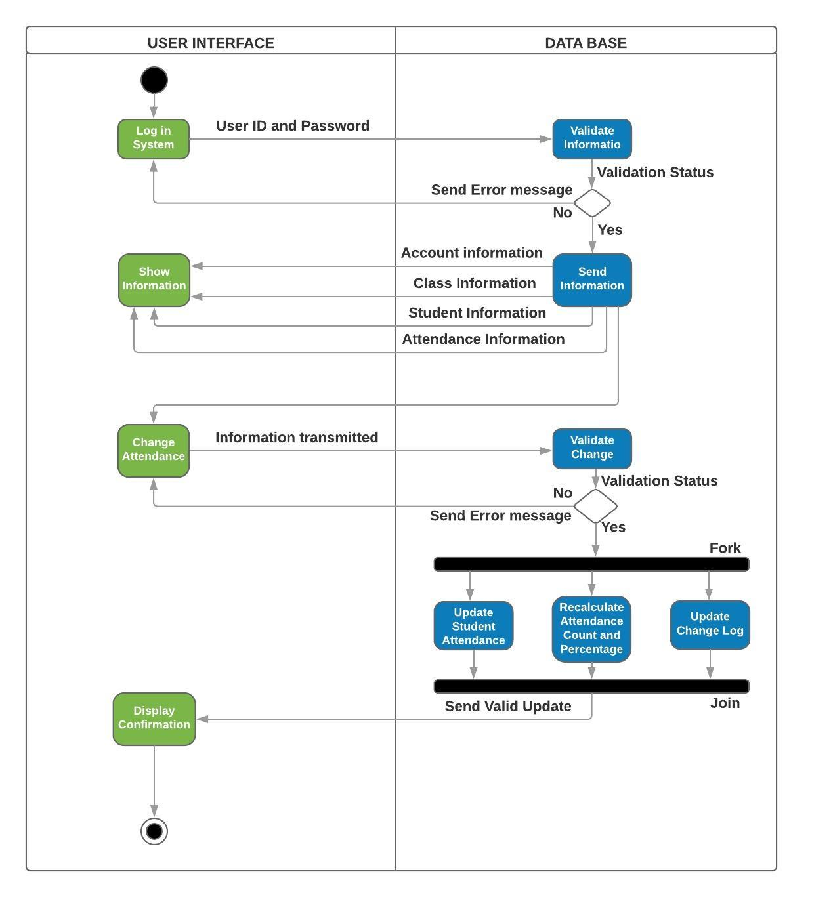

Slide 7
Sequence Diagram

Slide 8
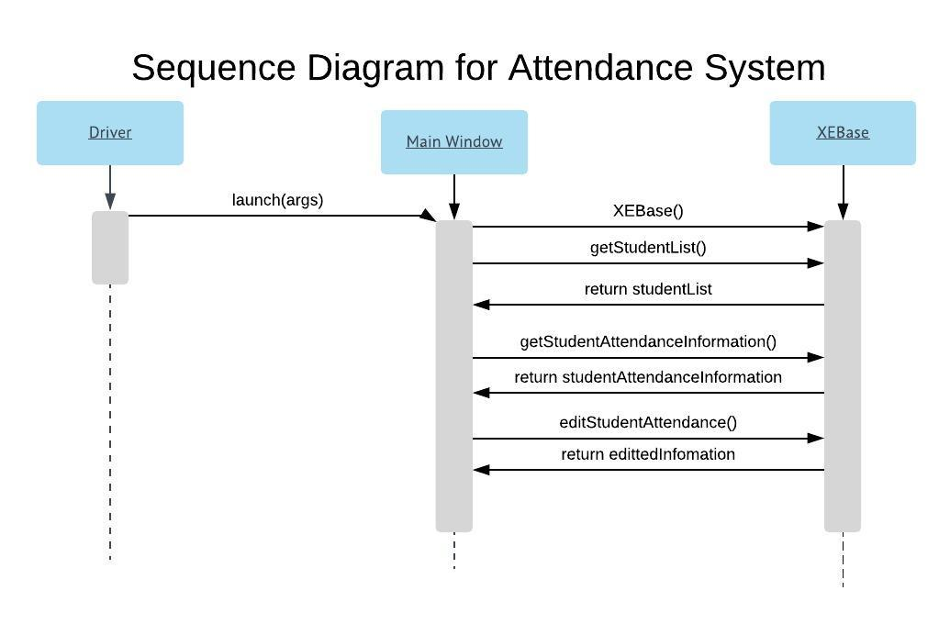

Slide 9
Class Diagram

Slide 10
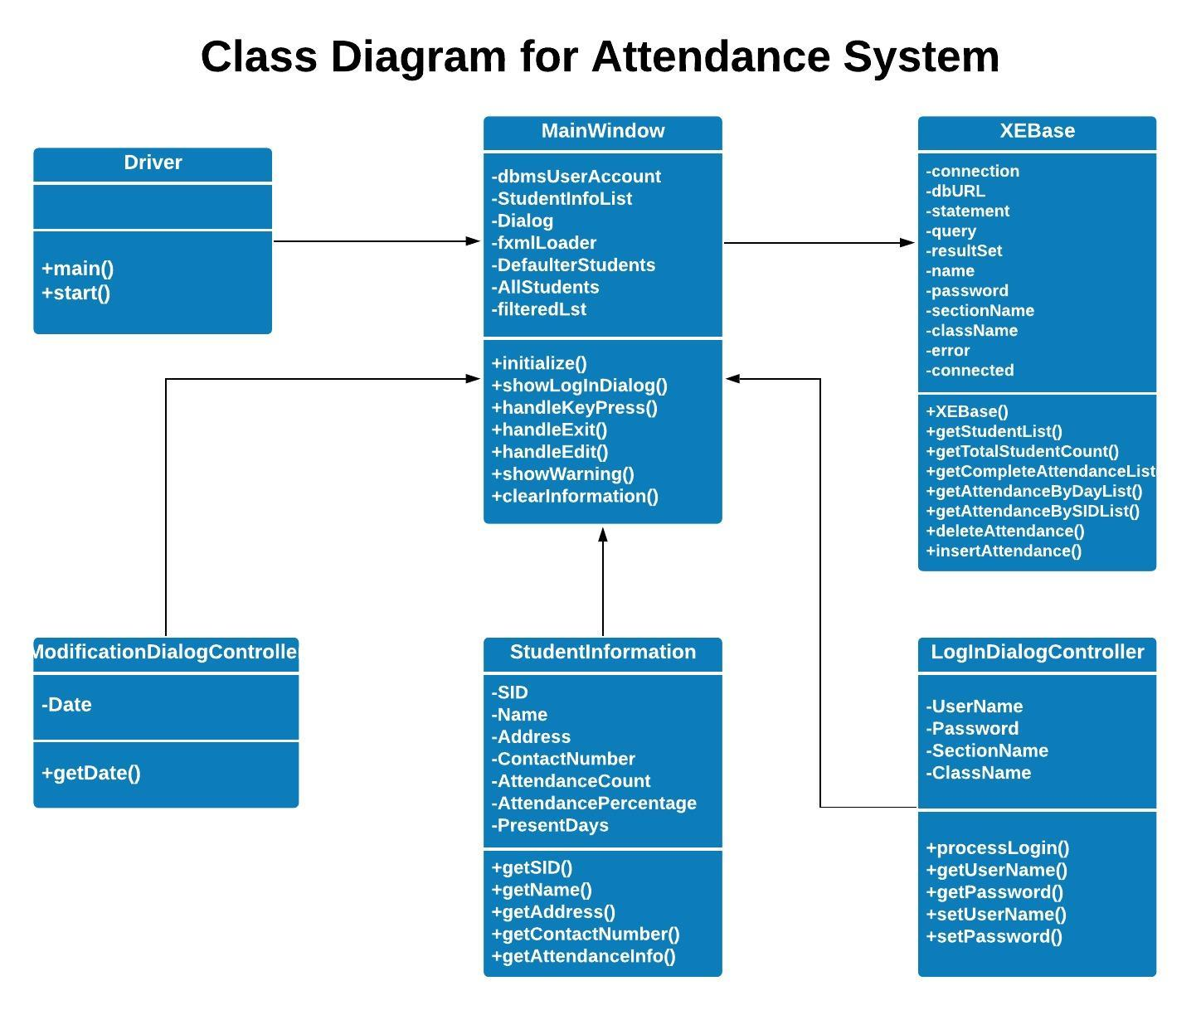

Slide 11
Thank you!

